Slide 1
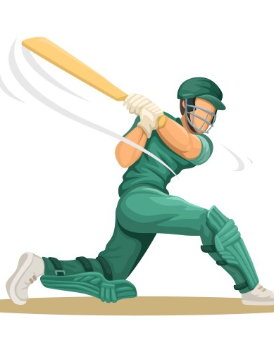
Craze of cricket in Kathmandu valley
Team-Gurkha
Team Members:
Mr. Nisham Gautam(C)
Mr. Agraj Pokhrel
Mr. Jason Bajracharya
Mr. Sambyak Darshandhari
Mr. Lavya Udash
Mr. Prashanna Gaire
Mr. Suraj Patel

Slide 2
TABLE OF CONTENT
1
2
3
4
5
INTRODUCTION
OBJECTIVES
LIMITATION
ANALYSIS
CONCLUSION

Slide 3
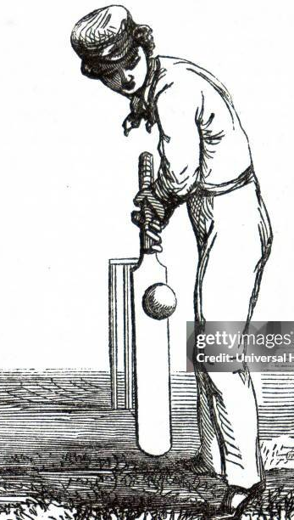
Introduction
Nepal as an emerging cricketing nation..
Gained ODI status in 2018..
Participated in multiple ICC tournaments..
National team gains global recognition ..
Country continues to improve its cricketing infrastructure..

Slide 4

Objectives
To analyze the growth of cricket popularity.
To explore impact of cricket on youths.
To highlight the role of cricket in shaping national identity

Slide 5

Limitations
Response Biasness ..
Limited Awareness..
Disinterested in surveys..
Language barriers..

Slide 8
3. Which season is most preferred for playing cricket in Kathmandu Valley?

Slide 9
4)Where is cricket mostly played in Kathmandu valley ?

Slide 10
5. Which cricket format is most popular among cricket fans in Kathmandu Valley?

Slide 11
6. What is the main medium through which cricket fans in Kathmandu follow matches?

Slide 12
7. Who is considered the most favorite cricketer among Kathmandu Valley residents?

Slide 14
9. What is the impact of cricket on youth in Kathmandu Valley?

Slide 15
10. What is the role of social media in promoting cricket in Kathmandu Valley?

Slide 16
11. How often do cricket tournaments take place in Kathmandu Valley?

Slide 17
12. Which group plays the most important role in organizing cricket tournaments in Kathmandu?

Slide 18
13. What motivates people in Kathmandu Valley to watch cricket?

Slide 19
14. What is the future of cricket in Kathmandu Valley?

Slide 20
15. What is the most popular time for cricket matches in Kathmandu?

Slide 21
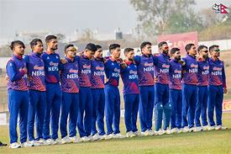
Conclusion
Crickets Popularity- Rapidly Growing among all age groups
Major tournaments- Boost enthusiasm and fan engagement
Infrastructural development- More ground and academies emerging
Future prospects- Bright with increasing local talent

